Slide 1





Smart Click
Multi-Location Wireless Light Switch

Slide 2
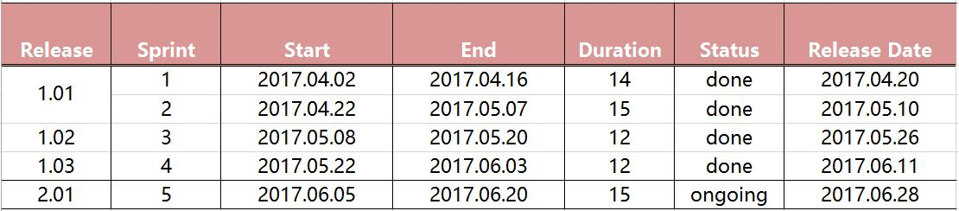
Release Plan

Slide 3
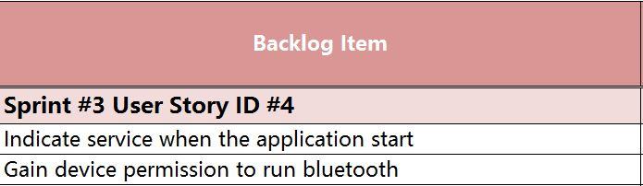
Sprint 3 Backlog
As an User I want my application to automatically connect to Bluetooh

Slide 4
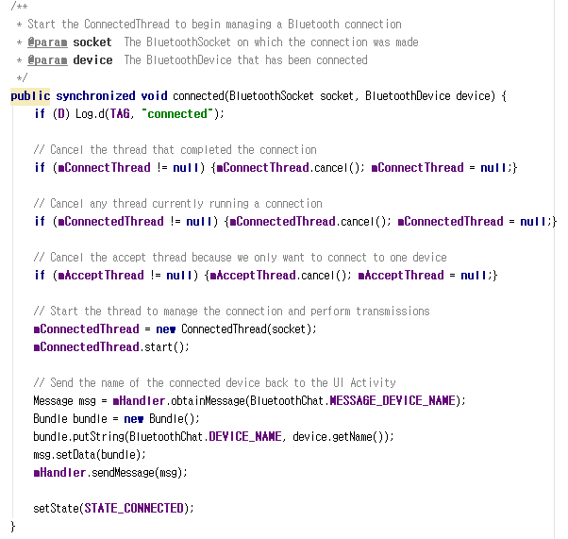
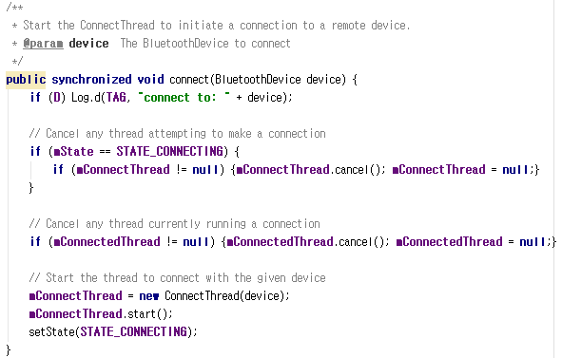
Gain device permission to run bluetooth

Slide 5
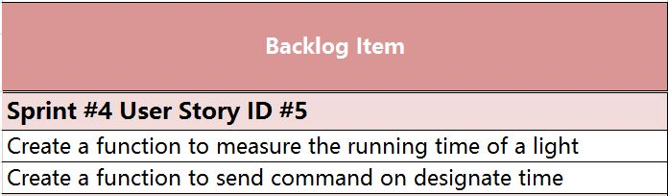
Sprint 4 Backlog
As an User I want to schedule light live-time

Slide 6
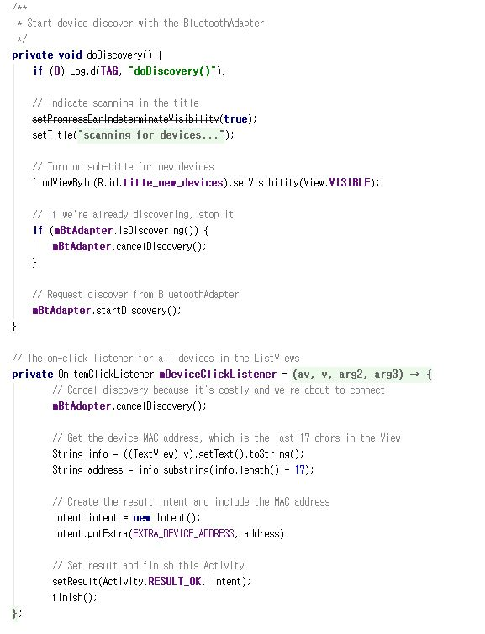
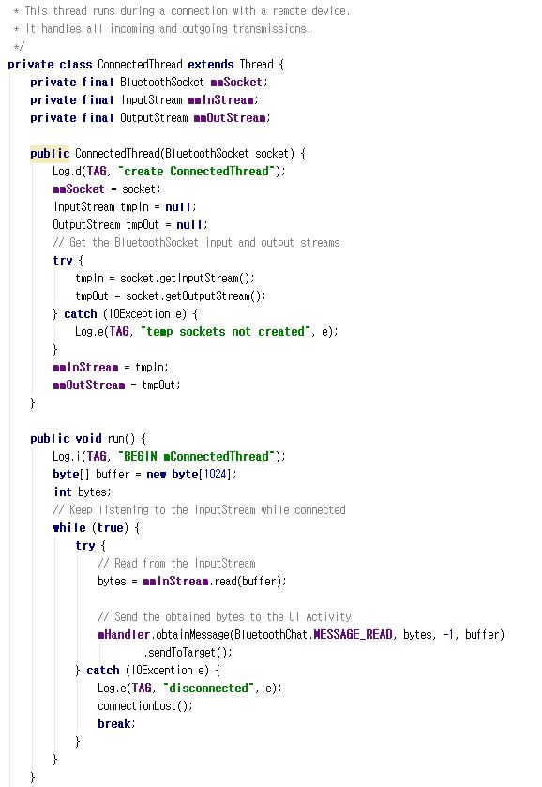
Create a function to measure the running time of a light
Notes:
This is configuration architecture.

Slide 7
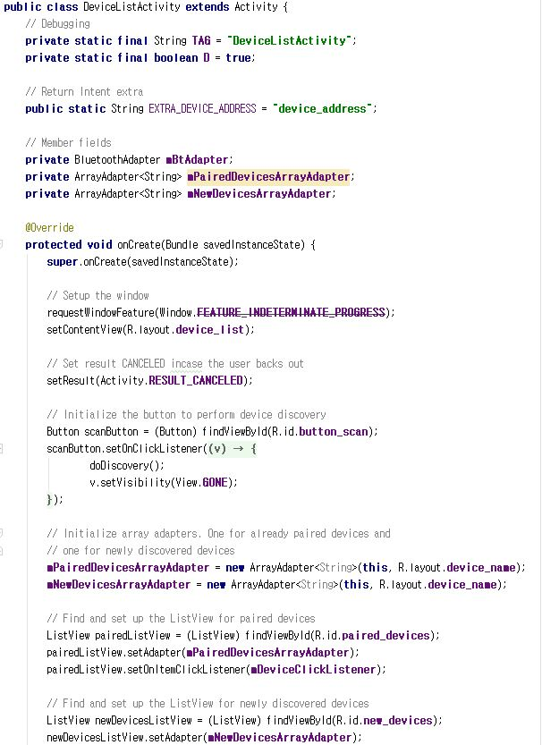
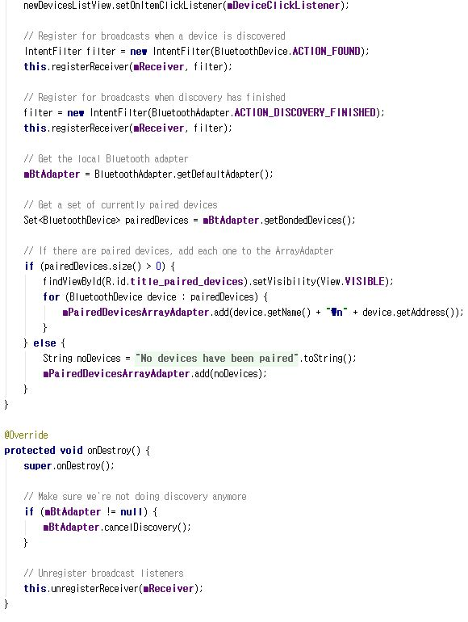
Create a function to send command on designate time
Notes:
This is configuration architecture.

Slide 8
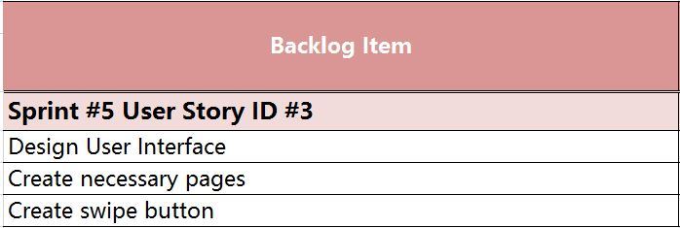
Sprint 5 Backlog
As an User I want swipe the control button on my application

Slide 9
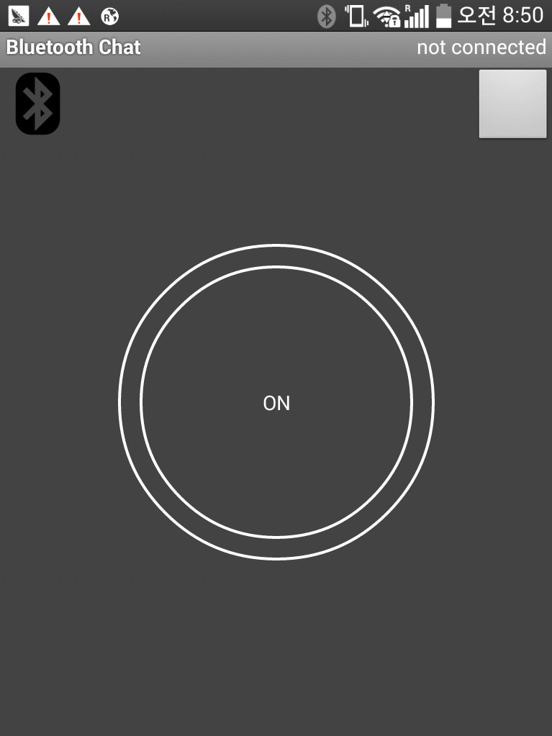
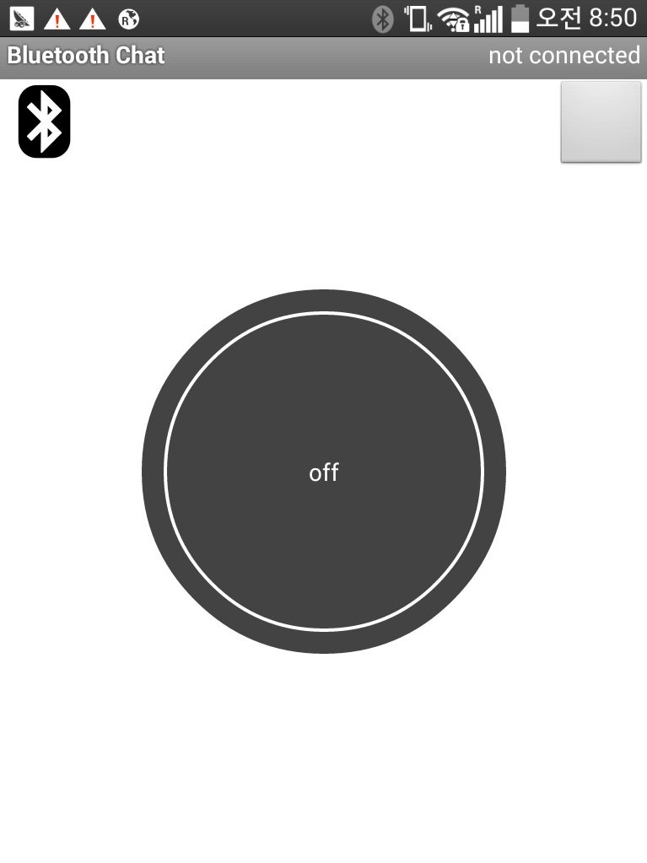
Design User Interface
Notes:
This is configuration architecture.

Slide 10
Create swipe button
swipe button
Notes:
This is configuration architecture.

Slide 11
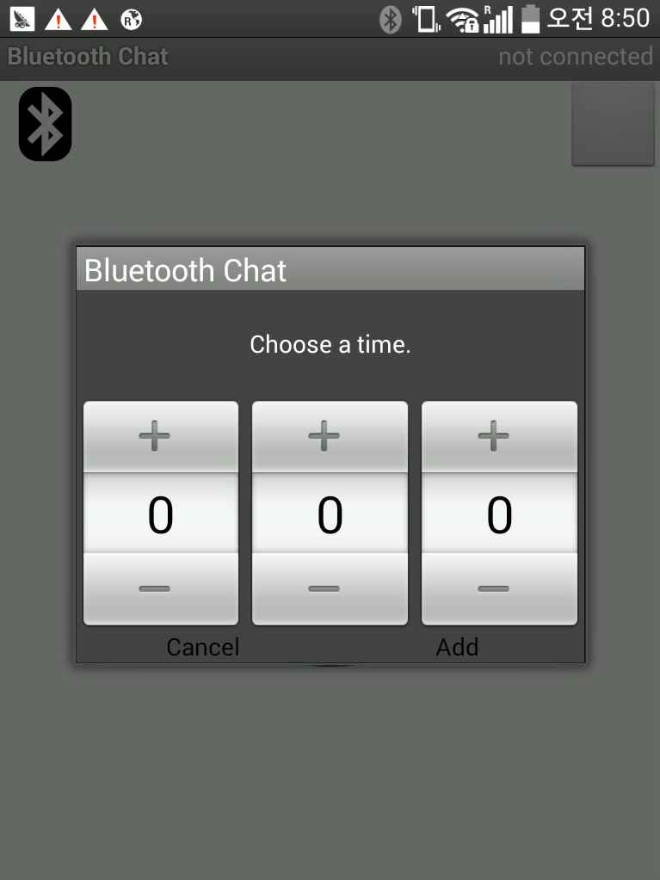
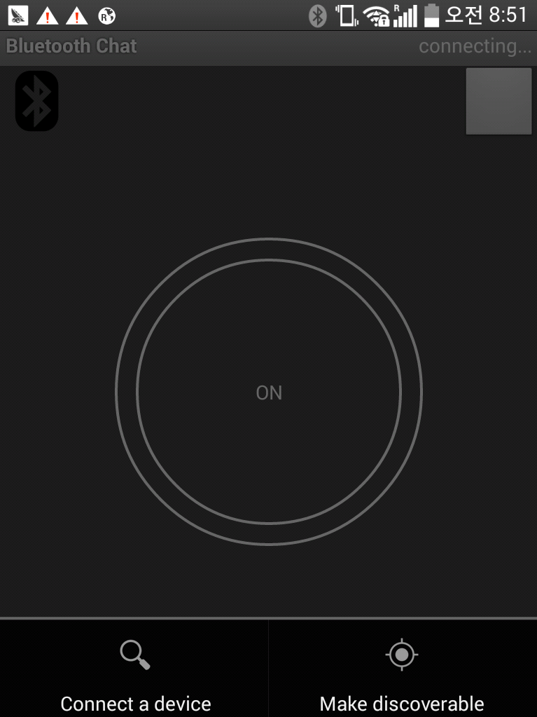
Create necessary pages
Alarm page
bluetooth page
Notes:
This is configuration architecture.

Slide 12
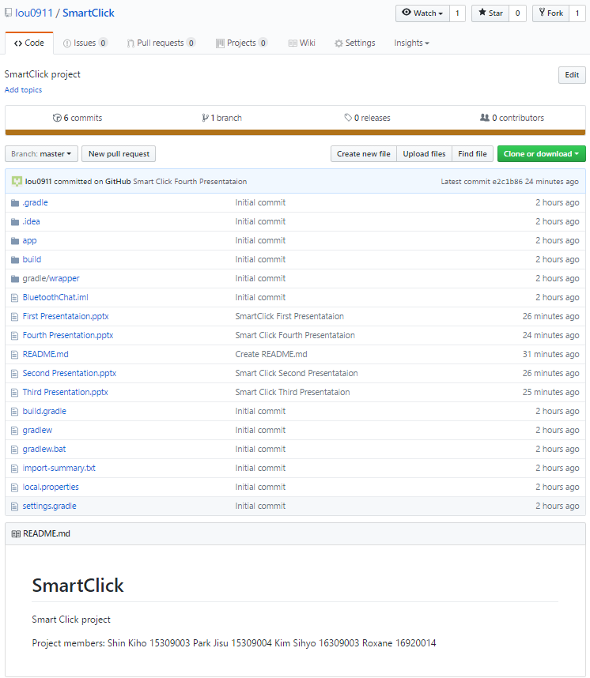
configuration management
Github address :
https://github.com/lou0911/SmartClick.git
Notes:
This is configuration architecture.

Slide 13
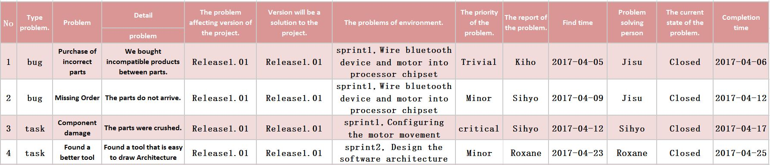
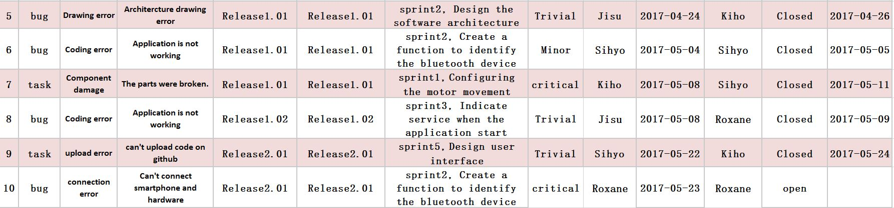
Defects Management

Slide 14


